Slide 1


<Vo Nhat Nam>
<27/06/2023>

Slide 2

Outline
Executive Summary
Introduction
Methodology
Results
Conclusion
Appendix

Slide 3
Executive Summary
Collected data from public SpaceX API and SpaceX Wikipedia page. Created labels column ‘class’ which classifies successful landings. Explored data using SQL, visualization, folium maps, and dashboards. Gathered relevant columns to be used as features.
Four machine learning models were produced: Logistic Regression, Support Vector Machine, Decision Tree Classifier, and K Nearest Neighbors. All models over predicted successful landings. More data is needed for better model determination and accuracy.

Slide 4
Introduction
Commercial Space Age is Here
Space X has best pricing ($62 million vs. $165 million USD)
Largely due to ability to recover part of rocket (Stage 1)
Space Y wants to compete with Space X
Problem: Space Y tasks us to train a machine learning model to predict successful Stage 1 recover

Slide 5

Section 1

Slide 6
Methodology
Executive Summary
Data collection methodology:
Collect data from Spacex Wiki and Spacex API
Perform data wrangling
Cleaning data and add label for landing successful and unsuccessful
Perform exploratory data analysis (EDA) using visualization and SQL
Perform interactive visual analytics using Folium and Plotly Dash
Perform predictive analysis using classification models
Try model and parameter with GridSearchCV

Slide 7
Data Collection
After we gathering data from 2 source, we have 2 table:
Space X API Data Columns include:
FlightNumber, Date, BoosterVersion, PayloadMass, Orbit, LaunchSite, Outcome, Flights, GridFins, Reused, Legs, LandingPad, Block, ReusedCount, Serial, Longitude, Latitude
Wikipedia Webscrape Data Columns include:
Flight No., Launch site, Payload, PayloadMass, Orbit, Customer, Launch outcome, Version Booster, Booster landing, Date, Tim

Slide 8
Data Collection – SpaceX API
Request API
Get json file from API text
Normalize json to pandas table
Filter the dataframe to
only include `Falcon 9` launches

Slide 9
Data Collection - Scraping
Request the Falcon9 Launch Wiki page from its URL
Extract all column/variable names from the HTML table header with beautifulSoup
Create a data frame by parsing the launch HTML tables

Slide 10
Data Wrangling
Dealing with Missing Values
Calculate the number of launches on each site
Calculate the number and occurrence of each orbit
Calculate the number and occurence of mission outcome of the orbits
Create a landing outcome label from Outcome column with landing successful is 1; otherwise is 0

Slide 11
EDA with Data Visualization
We can plot out the FlightNumber vs. PayloadMass and overlay the outcome of the launch. We see that as the flight number increases, the first stage is more likely to land successfully.
Visualize the relationship between Flight Number and Launch Site
Visualize the relationship between Payload and Launch Site
Visualize the relationship between success rate of each orbit type
Visualize the relationship between FlightNumber and Orbit type
Visualize the relationship between Payload and Orbit type
Visualize the launch success yearly trend

Slide 12
EDA with SQL
Queried using SQL Python integration.
Queries were made to get a better understanding of the dataset.

Slide 13
Build an Interactive Map with Folium
Mark the success/failed launches for each site on the map to see if the influence of the terrain helps with success
Calculate the distances between a launch site to its proximities

Slide 14
Build a Dashboard with Plotly Dash
Show Spacex Launch records dashboard
Includes a pie chart and a scatter plot
Pie chart for launch sites are selected
A Range Slider to Select Payload

Slide 15
Predictive Analysis (Classification)
Standardize
Spilt data
Test with each model logistic, KNN, Decision tree, SVM with GridSearchCV to find best parameter
Compare model with confusion models

Slide 16
Results
finally the results of our model with about 89% accuracy.

Slide 17

Section 2

Slide 18
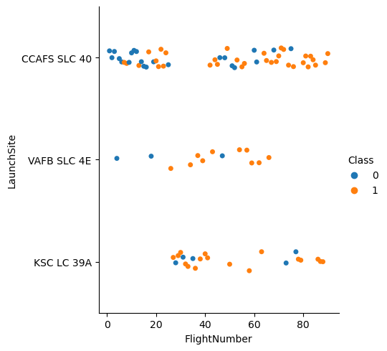
Flight Number vs. Launch Site
We see that as the flight number increases, the first stage is more likely to land successfully.

Slide 19
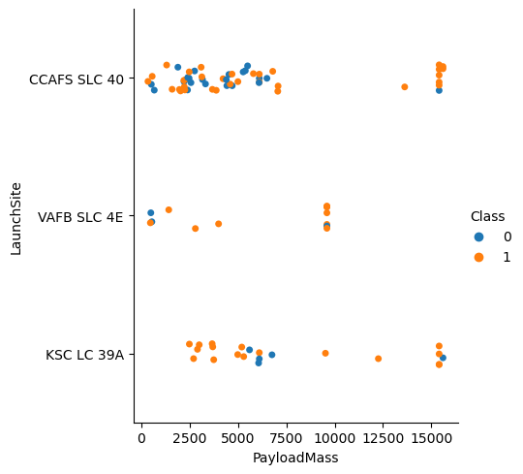
Payload vs. Launch Site
Different payload between launchsite

Slide 20
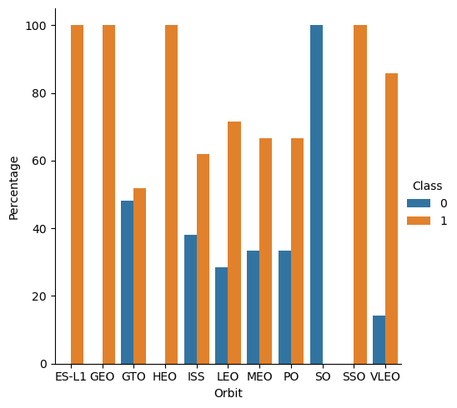
Success Rate vs. Orbit Type
ES-L1 and GEO successful completely and SO unsuccessful completely

Slide 21
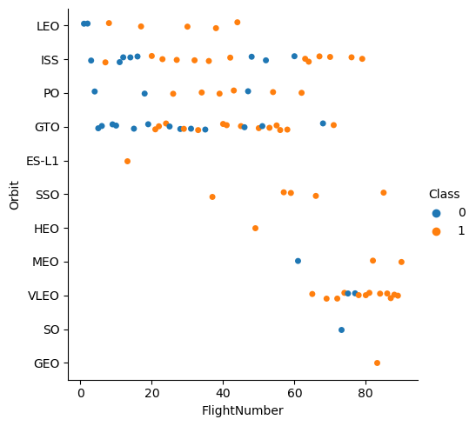
Flight Number vs. Orbit Type
You should see that in the LEO orbit the Success appears related to the number of flights; on the other hand, there seems to be no relationship between flight number when in GTO orbit.

Slide 22
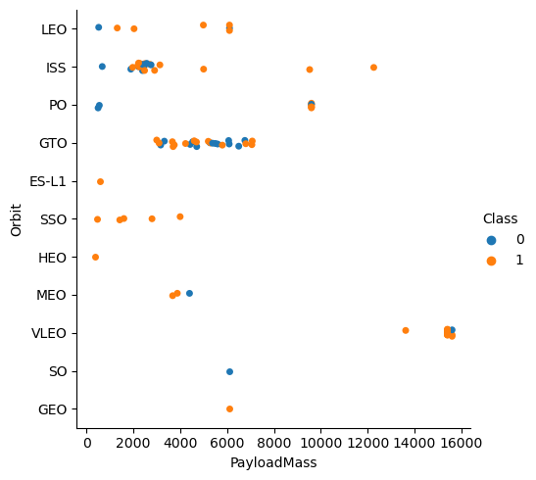
Payload vs. Orbit Type
With heavy payloads the successful landing or positive landing rate are more for LEO and ISS.
However for GTO we cannot distinguish this well as both positive landing rate and negative landing(unsuccessful mission) are both there here.

Slide 23
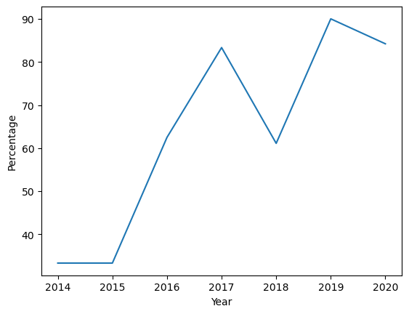
Launch Success Yearly Trend
Successful increase over time since 2013 but decrease strong in 2018

Slide 24
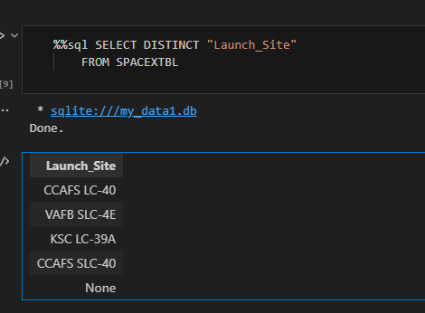
All Launch Site Names

Slide 25
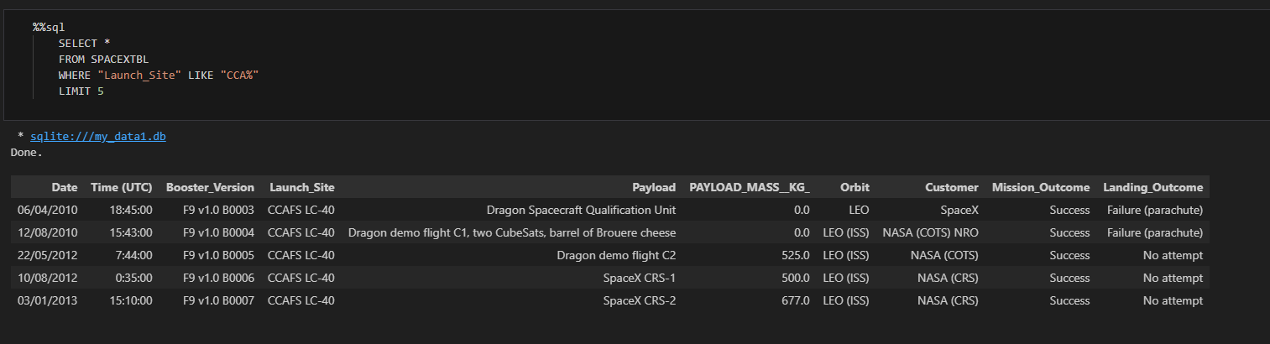
Launch Site Names Begin with 'CCA'

Slide 26
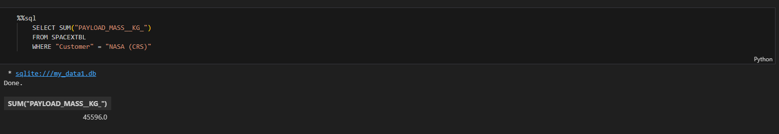
Total Payload Mass

Slide 27
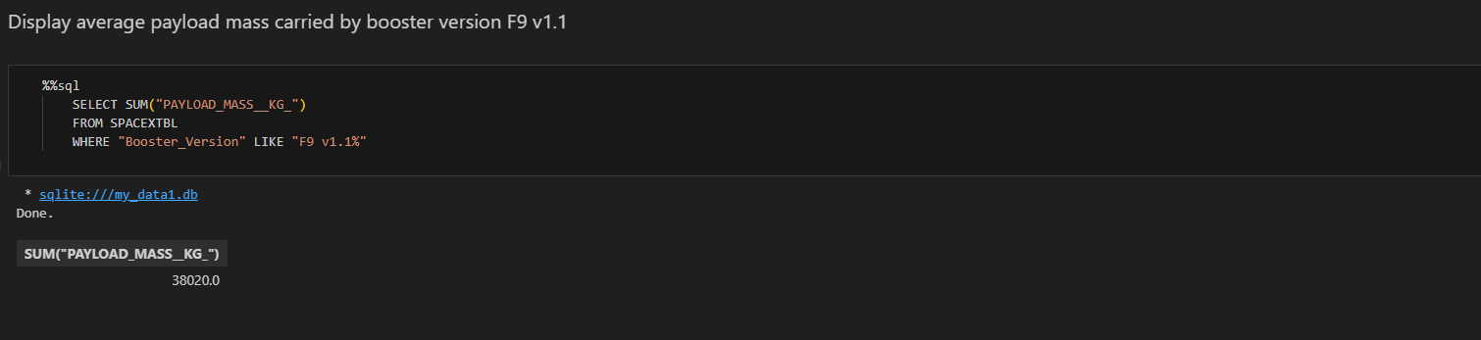
Average Payload Mass by F9 v1.1

Slide 28
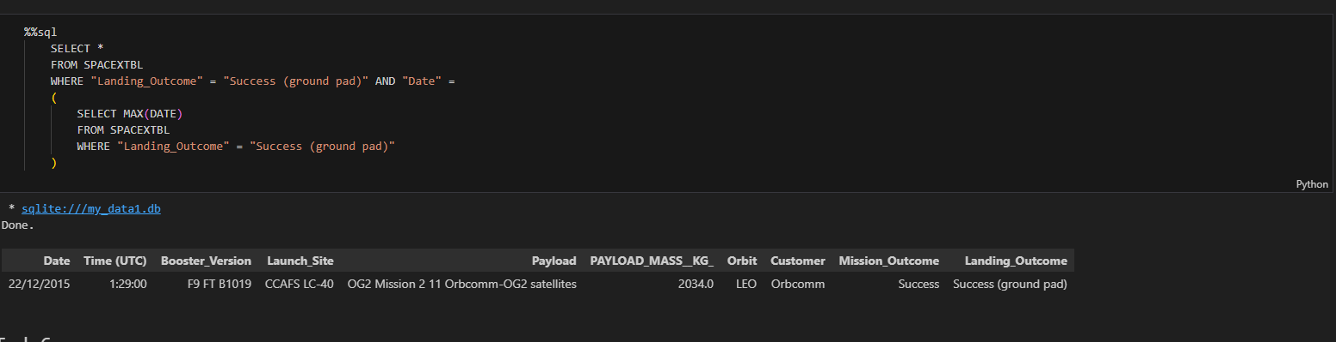
First Successful Ground Landing Date

Slide 29
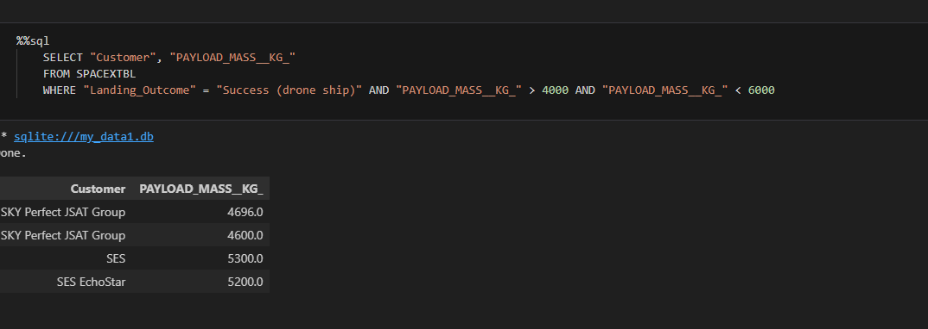
Successful Drone Ship Landing with Payload between 4000 and 6000

Slide 30
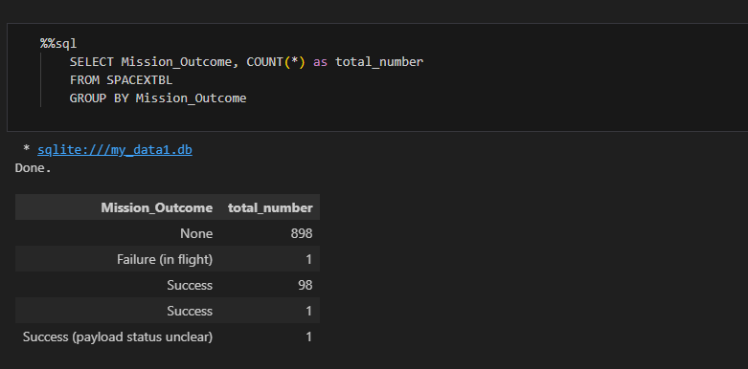
Total Number of Successful and Failure Mission Outcomes

Slide 31
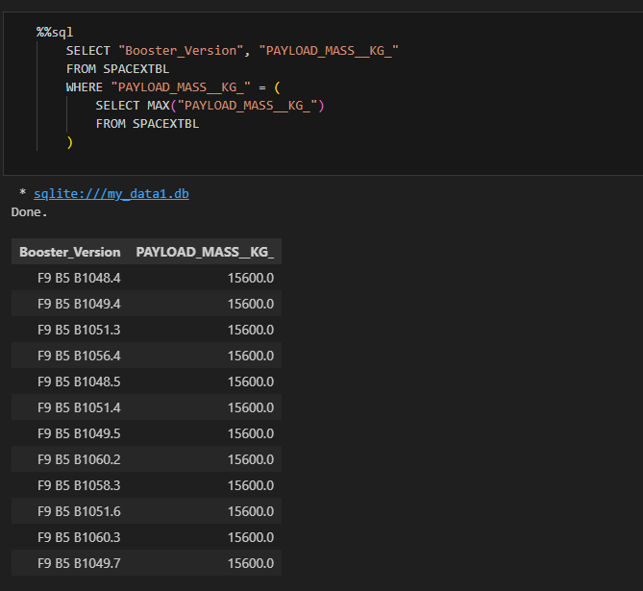
Boosters Carried Maximum Payload

Slide 32
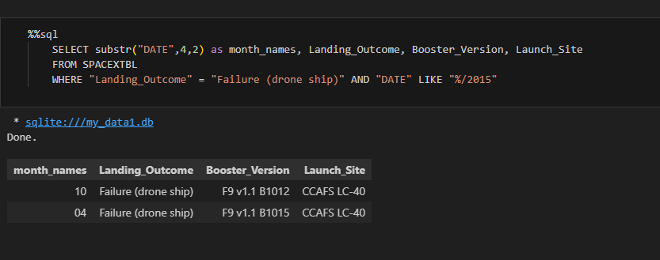
2015 Launch Records

Slide 33
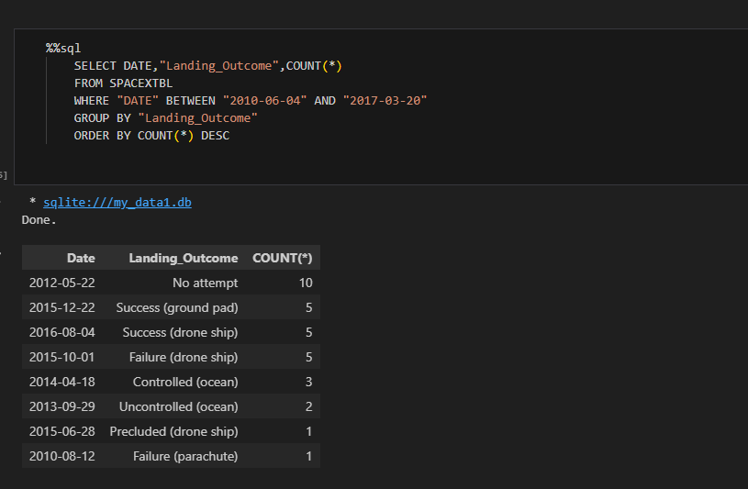
Rank Landing Outcomes Between 2010-06-04 and 2017-03-20

Slide 34

Section 3

Slide 35
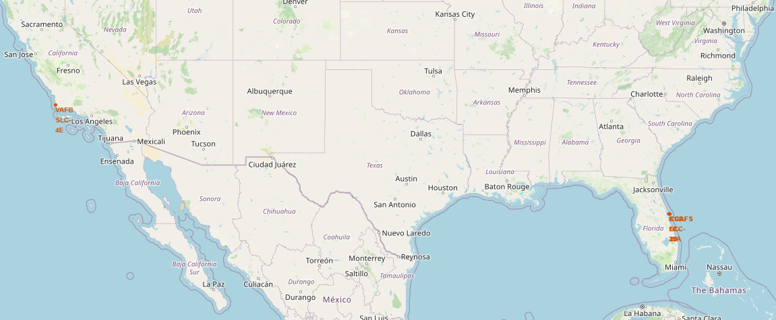
Launch Site Locations

Slide 36
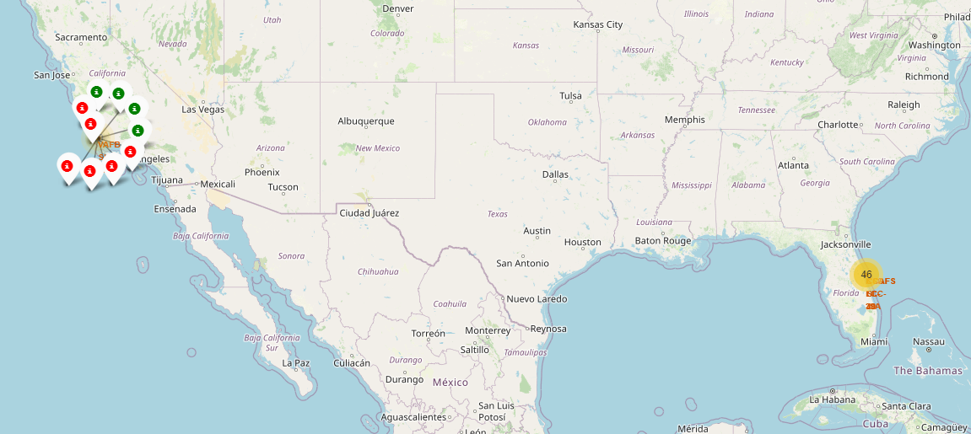
Color-Coded Launch Markers

Slide 37
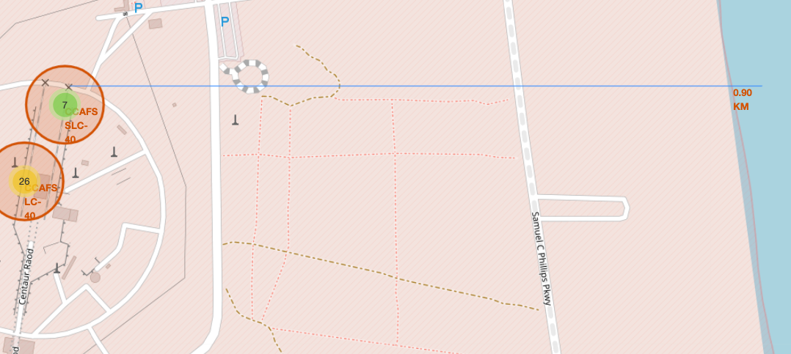
distances between a launch site to its proximities

Slide 38

Section 4

Slide 39
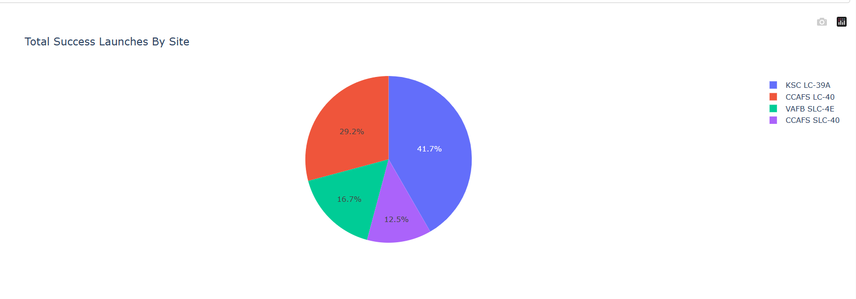
Rate successful in launch Site

Slide 40
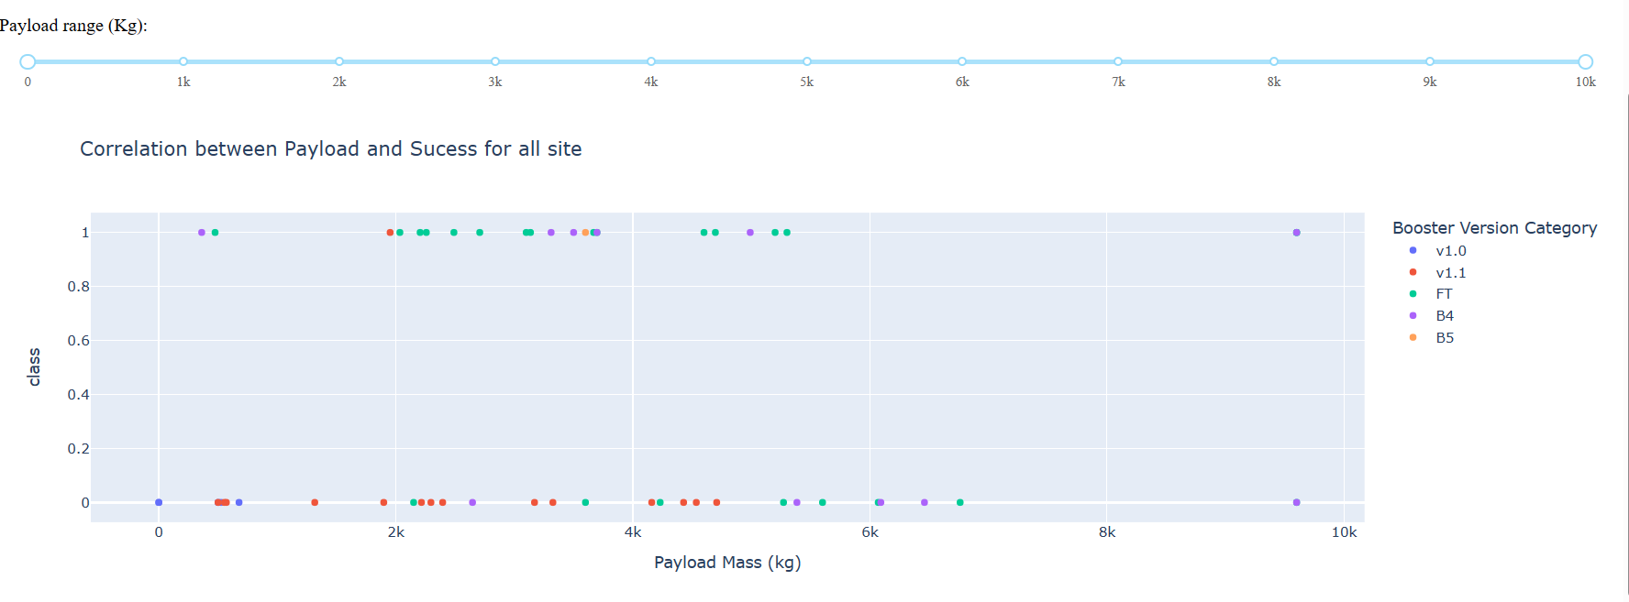
Correlation payload and success for Launch Site

Slide 41

Section 5

Slide 42
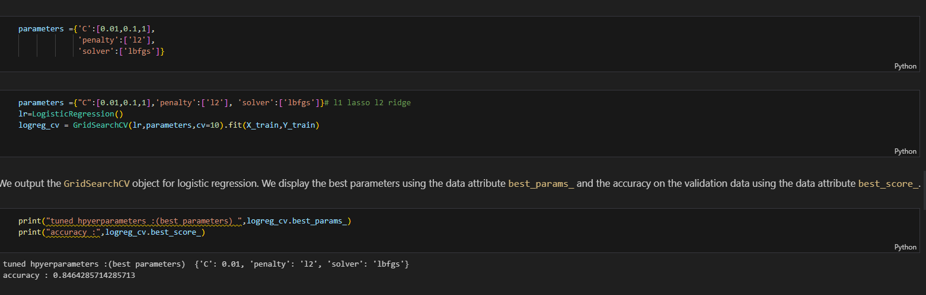
Logistic regression classification Accuracy

Slide 43
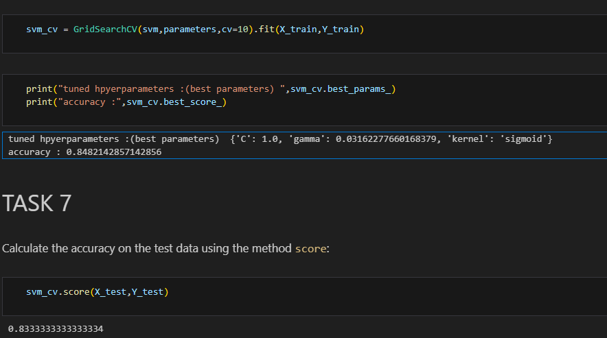
Support vector machine Classification Accuracy

Slide 44
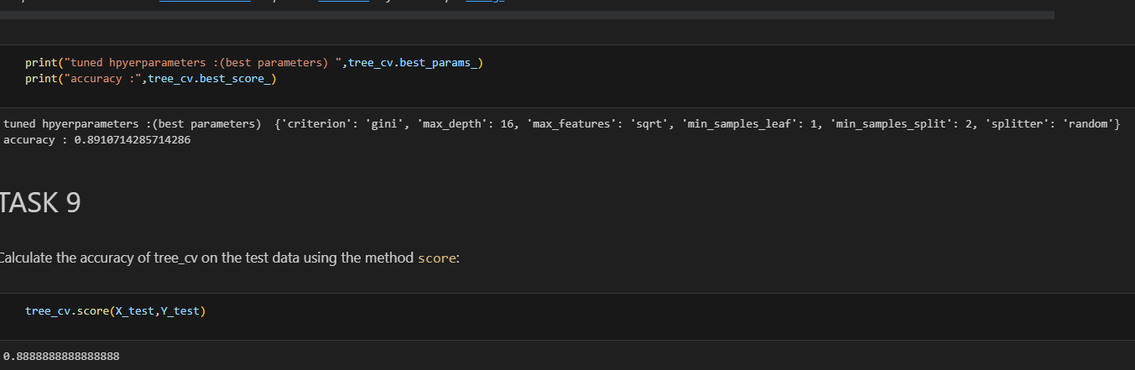
Decision Tree Classification Accuracy

Slide 45
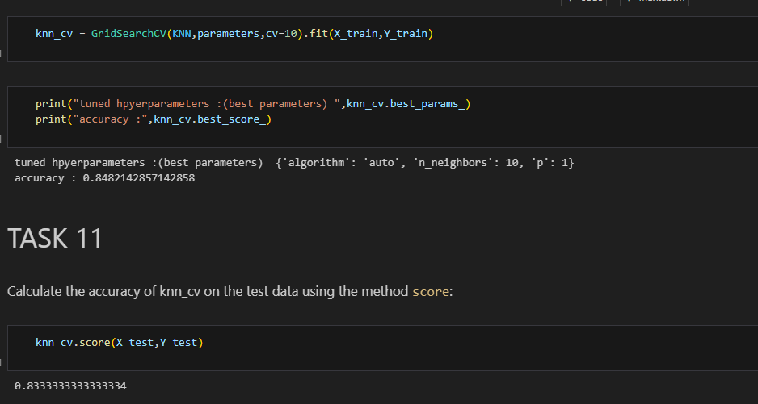
K-nearest neighbors classification Accuracy

Slide 46
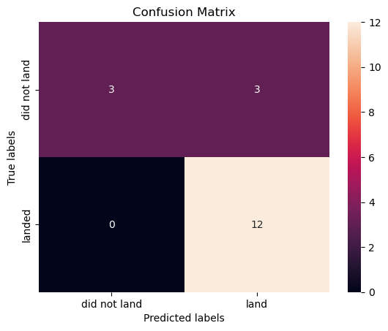
Confusion Matrix
Since all models performed the same for the test set, the confusion matrix is the same across all models. The models predicted 12 successful landings when the true label was successful landing.

Slide 47
Conclusions
Our task: to develop a machine learning model for Space Y who wants to bid against SpaceX
The goal of model is to predict when Stage 1 will successfully land
We created a machine learning model with an accuracy of 83% ◦
Allon Mask of SpaceY can use this model to predict with relatively high accuracy whether a launch will have a successful Stage 1 landing before launch to determine whether the launch should be made or not

Slide 48
Appendix
Github url:
https://github.com/Nam1212/Applied-Data-Science-Capstone/tree/161c299d03bdd45ef3ebeff011f5517635ffed6d/Applied%20Data%20Science%20Capstone

Slide 49


